Slide 1
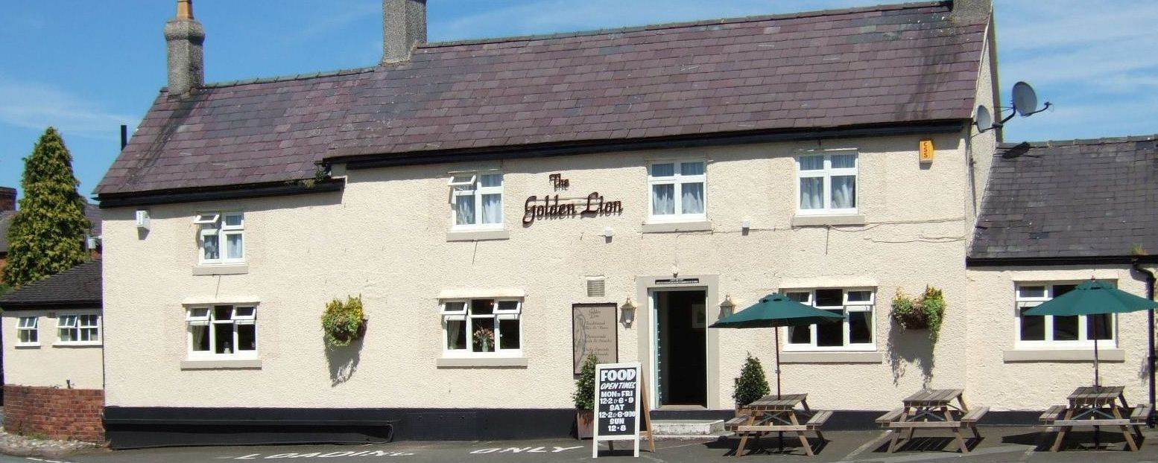
Save The Golden Lion
Share Offer Meeting
22nd February 2018

Slide 2
Objective of this Meeting
To update you as to the current position
Outline the Share Offer
Proposed next steps
Address questions arising
Obtain feedback and comment

Slide 3
Agenda
Background & Progress Update
Ashton Hayes Community Hub Ltd
The Share Offer
Site Visit
How this has Worked Elsewhere
Benefits of Supporting the Offer
Survey Results
Next Steps
Q&A
Keep in Touch
Thank you to Plunkett Foundation
Feedback

Slide 4
Background
2013
January Pub closed
2016
January Initial views of community sought
July Initial building survey and valuation
2017
March Community interest to purchase raised with owner
May CWaC consulted
June Further informal discussions with owner reach impasse
July NP developed and adopted by Chester West & Chester Council
Summer Working group review options and develop broad approach
October GL put on market and Plunkett engaged
October 25 Residents Consultation Meeting
Notes:
Oct Survey delivered and collected

Slide 5
Progress since last Meeting
2017
November Survey results collated and analysed
December Website launched and survey results published
December Site visit to determine work required
December Ashton Hayes Community Hub Ltd formed
December Formal offer made
2018
January Work on the Business Plan and Prospectus begins
January Funding applied for
February Publicity material produced
February Business Plan and Prospectus finalised
Today Share Offer Meeting
Notes:
Formal offer made through agents

Slide 6
Ashton Hayes Community Hub Ltd
Has been set up as a Community Benefit Society
It is able to borrow monies against the asset
It is able to issue shares
It is able to limit the liability of participants
It is legally sound and meets requirements of official bodies
Actively seeks and takes on board advice from experienced bodies such as Plunkett
Notes:
Is able to borrow monies against the asset
Is able to issue shares
Is able to limit the liability of participants
Is legally sound and meets requirements of official bodies
Takes on board advice from experienced bodies such as Plunkett
What are you investing in?

Slide 7
The Share Offer
Currently being prepared for distribution to all properties and contains :-
Share Offer Summary
Statement of Our vision and the benefits to the community
Outline of our business model
Actions to secure the Golden Lion
Summary five year financial forecasts & capital repayments
Key risks and mitigations
Details of how you can be involved
Introduces the interim management committee
Details of the Share issue
Typical questions and answers
Application procedure
Application form

Slide 8
What are We Investing in??
You are buying a share of the CBS ‘Ashton Hayes Community Hub Ltd’
That organisation owns and manages an asset, the Golden Lion
You are investing in a highly valued Community Asset
A Share Offer awarded the Community Shares Quality Award
What condition is the asset in currently?
Notes:
The Prospectus and Business Plan have been reviewed and assessed by an independent organisation that assesses the content, financial projections and plans and the overall quality of planning for a community share offer such as ours. Our Share Offer has been awarded the Community Shares Quality Award.
You may have wondered what condition the property is in internally?
Trevor and David took a few photographs of the pub when they visited in December ..... A visual indication only of condition…..

Slide 9
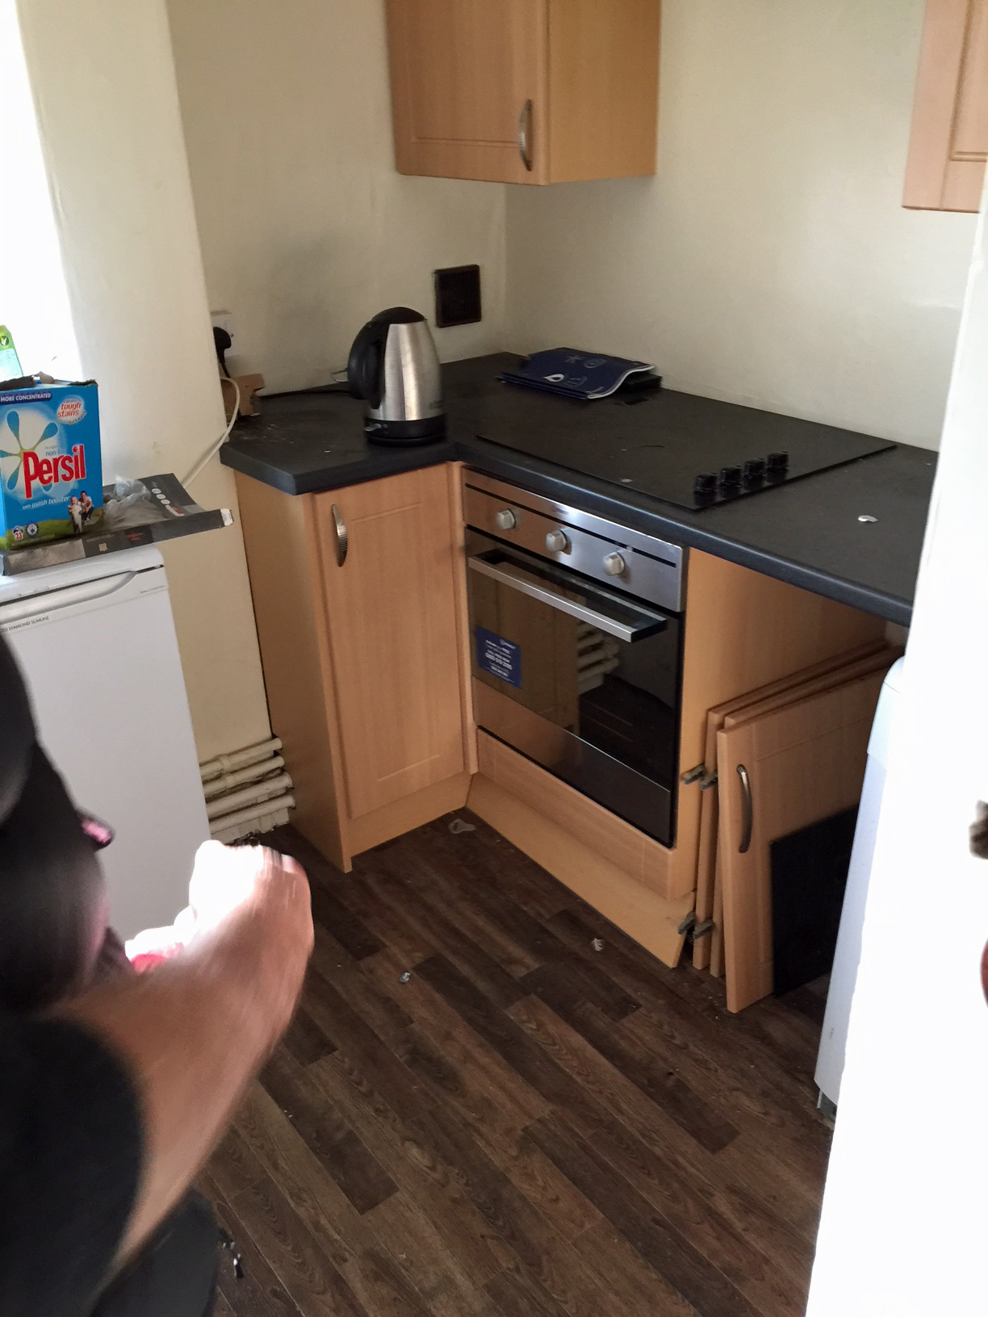
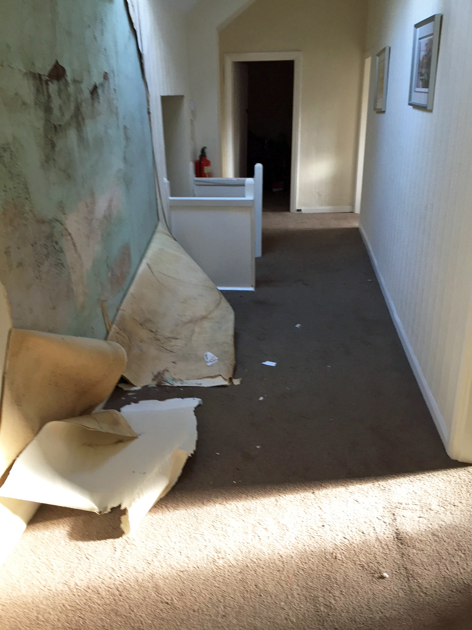

Slide 10
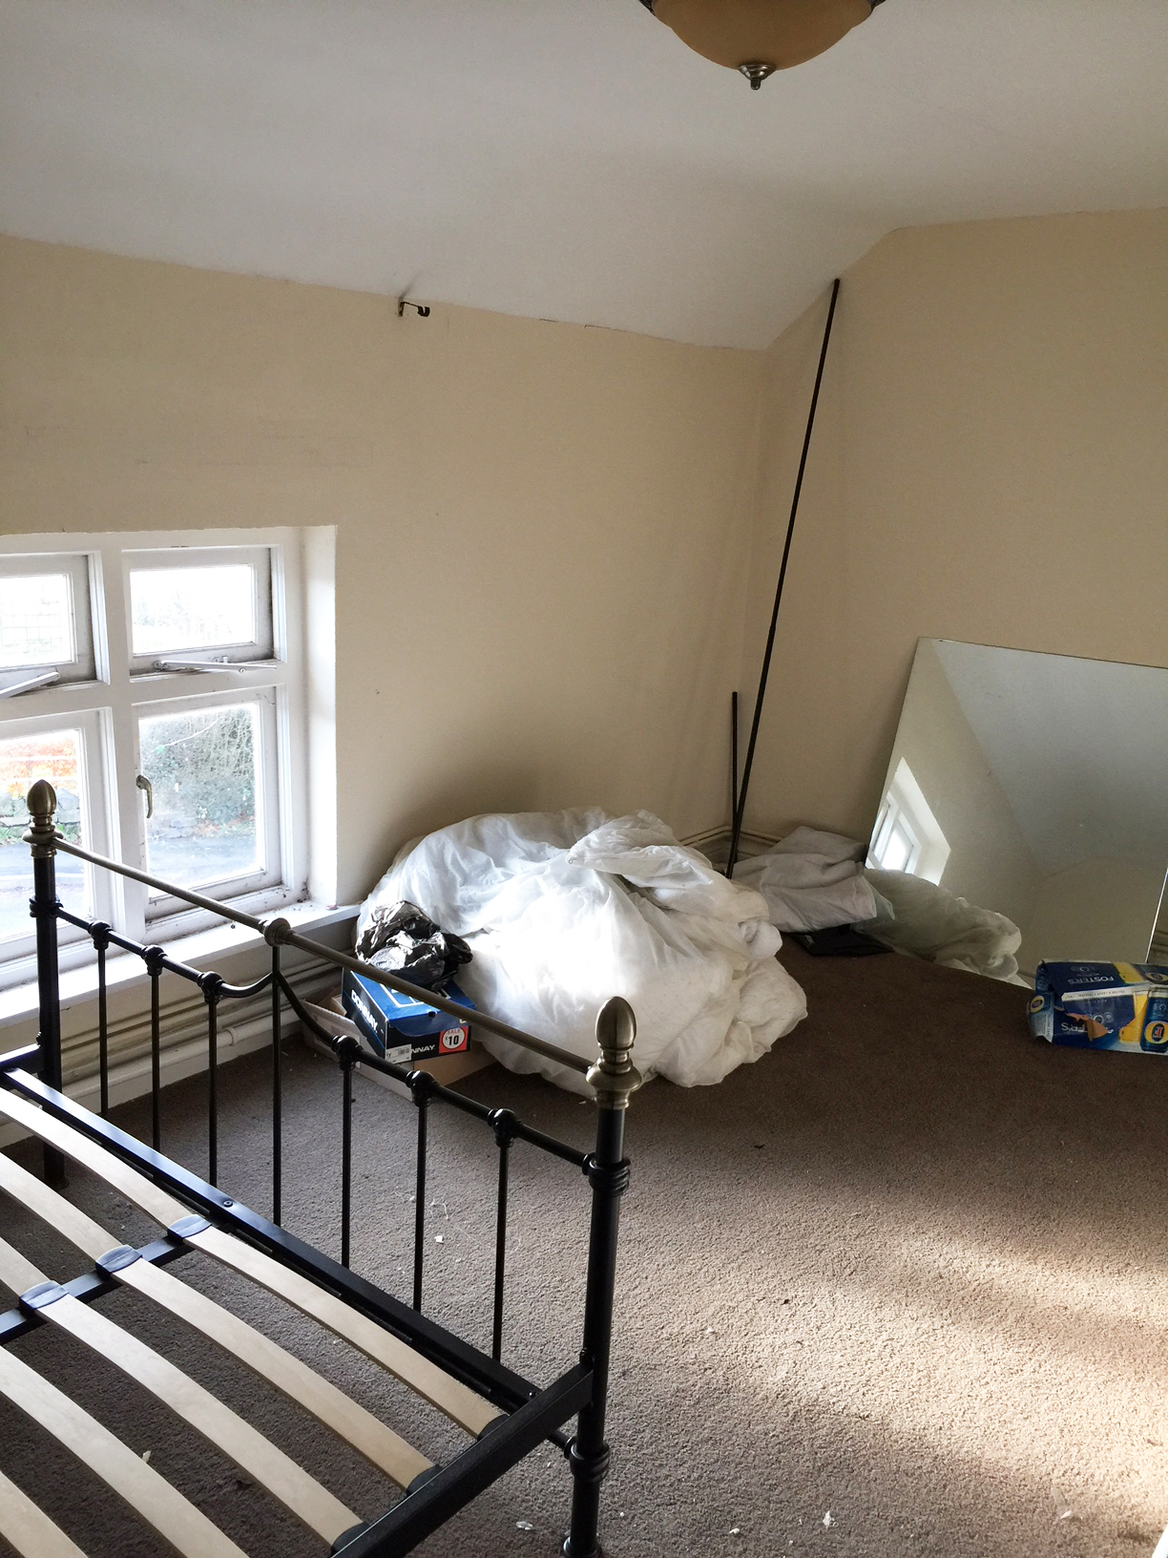
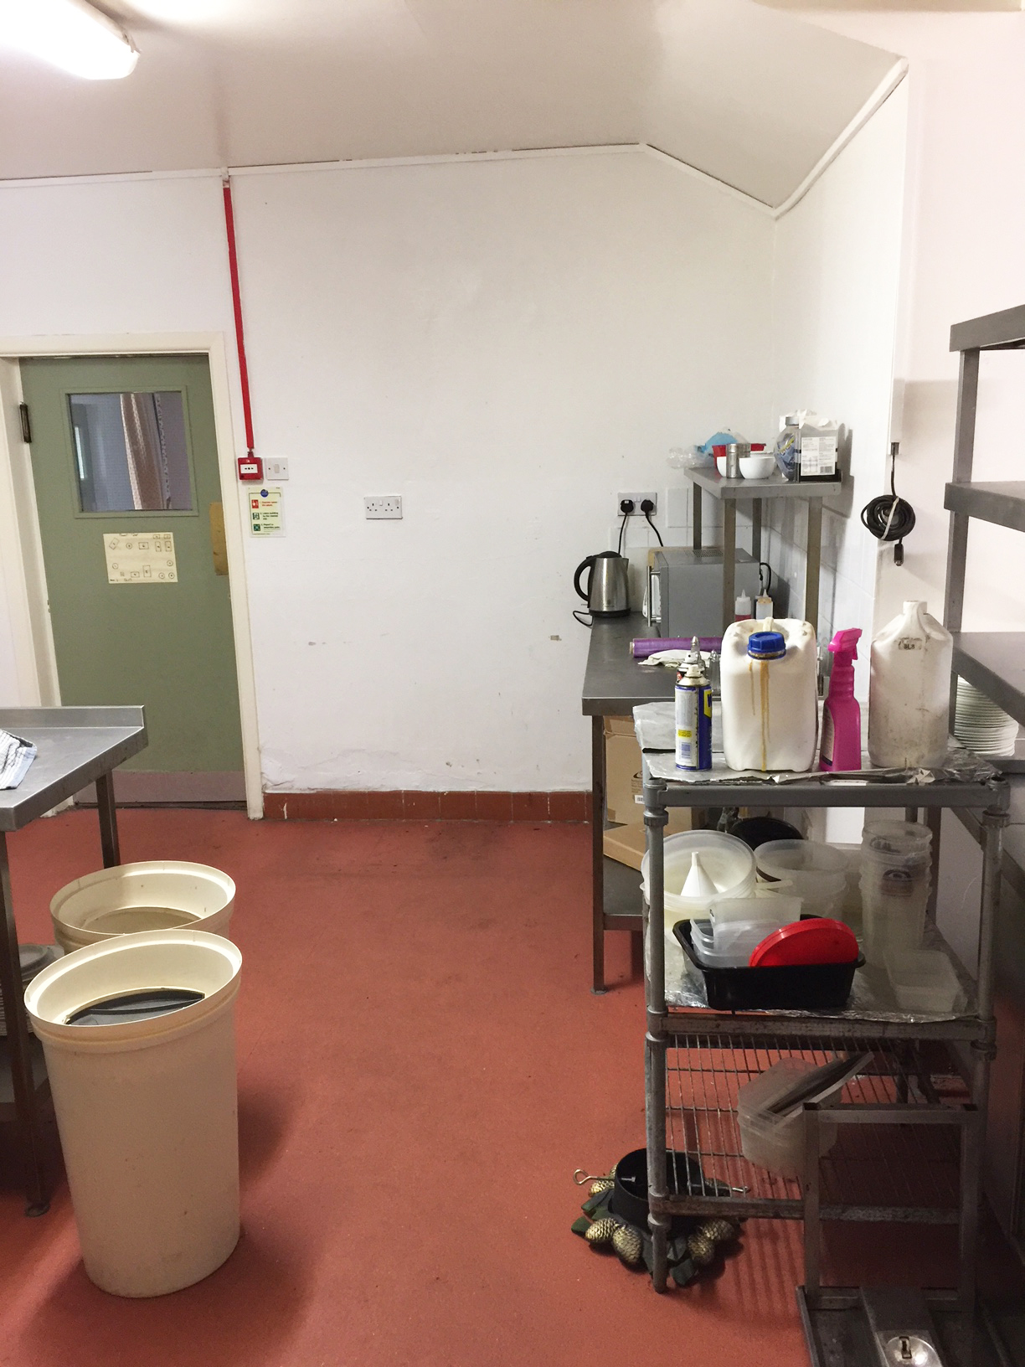

Slide 11
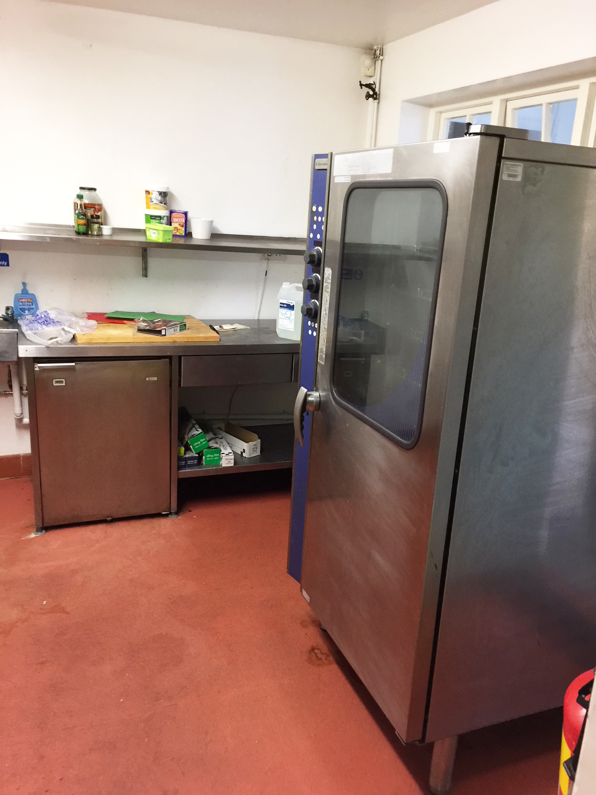
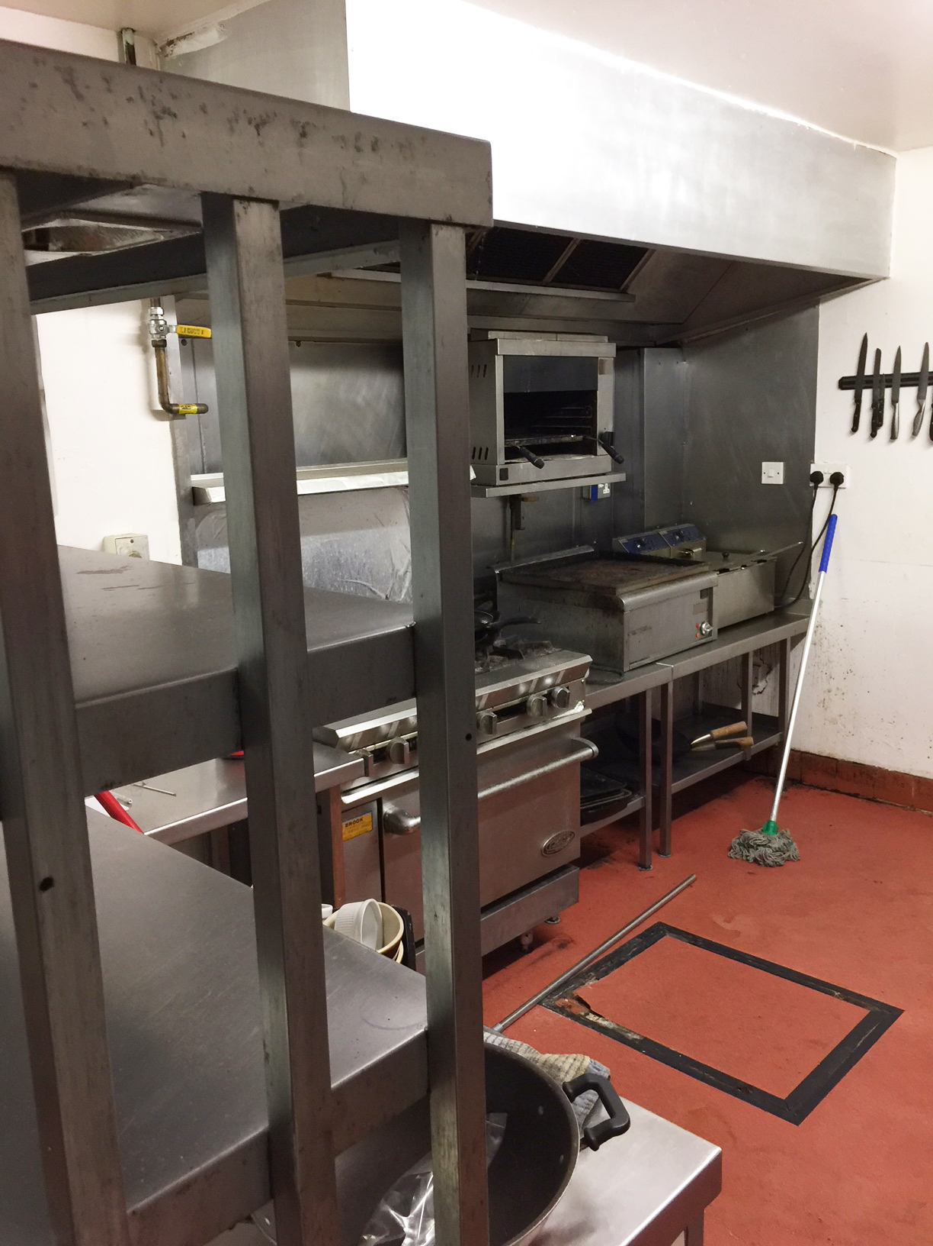

Slide 12
Key Details of the Share Offer
Launch date is 26th February 2018
Close date end is 28th March2018
The Prospectus will be distributed to all properties in the parish and by email to other people outside the parish who have shown interest
The Business Plan will also be used to support applications to grants and loan awarding bodies

Slide 13
Key Figures Within the Prospectus
We are aiming to raise £522,000 overall for the purchase, refurbishment and initial operating funding.
The share offer is through a community investment and we have a target to achieve a minimum of £250,000 in investment from the share offer to deliver our business plan.
The minimum investment is £200 per investor, with a maximum of £25,000 per individual investor.
Organisations who wish to support the Golden Lion are welcome to invest in the same way to a maximum to £100,000 to allow for an investment from the Community Share Booster Program.
Notes:
We are aiming to raise £522,000 overall for the purchase, refurbishment and initial operating funding. This will be raised through a community share offer, share match grants/loans, grants and potentially a mortgage against the property.
The share offer is through a community investment (with a maximum subscription of £422,000), to purchase and refurbish the Golden Lion, and to run it successfully. We need to achieve a minimum of £250,000 in investment from the share offer to deliver our business plan.
Organisations who wish to support the Golden Lion are welcome to invest in the same way and the management committee has agreed to increase the maximum to £100,000 for an investment from the Community Share Booster Program.
The management committee reserves the right to extend the offer beyond this initial period if they believe doing so would benefit the share issue.

Slide 14
So has this approach worked elsewhere?
Yes is the straight answer! The Spotted Cow at Holbrook is one of well over 50 Community owned and run pubs currently in business
Not one Community owned and managed pub has closed since it opened Source; Plunkett Foundation
https://goldenlionashtonhayes.co.uk/the-spotted-cow-at-holbrook/
Notes:
Spotted Cow, Holbrook in Derbyshire. The Spotted Cow re-opened in July 2017 after being saved by the local community.
The pub is managed by a husband-and-wife team, landlord and landlady Paul and Cheryl Brew.
Although the pub is owned by The Holbrook Community Society, they have arrived at the same management structure decision as we have, they chose tenants to run the pub who understood their vision of an evolving model that caters for what the community needs and are tenants who have a wealth of experience in running successful pubs.
Short 5 min video of their experience.

Slide 15
Investor Benefits
Potential Benefits Include:
Confidence that we are securing a long term focal point for our community
Managing and owning a key village asset for the long term benefit of our residents
Potential to give long term security to numerous village projects and organisations
To improve and maintain the appearance of the centre of our village
Making Ashton Hayes more appealing to business and future investment/support
Obtaining a return on your investment
Making Ashton Hayes more appealing to new residents considering buying property

Slide 16
Community Benefits
Benefits include:
Strengthening the already strong community spirit and vibrancy of Ashton Hayes
Providing a central point of contact for community events
Developing a reputation for good ale and food, beyond the immediate environment
A venue for social, family and charity events in the local community
Re-investing surplus profits in refurbishing the Golden Lion to create a friendly, welcoming focus, whilst providing local employment
Using local produce, to strengthen the local economy and improve the environment

Slide 17
Numbers Responding to Pub Survey
Notes:
Numbers of adults involved and engaged through the Consultation

Slide 18
Responses to Pub Survey Questions

Slide 19
Next Steps
Share Offer Launch meeting today
Offer formally opens on Monday
Business Plan and Share Document available on the website
Press release to be sent out
Distribute Share Offer document to all homes
Drop in sessions at the parish rooms Saturday 3rd, 17th and 24th March
Continue publicising the share offer
Next Pop up Pub is 3rd March, 7.30 in the parish rooms
Let us have your email address for the latest updates
Spread the word!
Notes:
All the relevant information and documentation will be available to download over the weekend ready for the offer opening.
Thoughts, comments and Q’s post meeting =drop in sessions
PR = Interviews and articles BBC Merseyside Mon, number of papers and journals have expressed interest
Lots of chat, information and any potential updates available at the nest Pop Up Pub meeting
Emails addresses are really useful for keeping in touch.
Use social media or personal email groups to make others aware.

Slide 20
Q&A and Keep in Touch
Website: goldenlionashtonhayes.co.uk
Facebook: facebook.com/thegoldenlionashtonhayes/
Twitter: twitter.com/goldlionashton
Email: goldenlionashtonhayes@btinternet.com

Slide 21
Thank You to The Plunkett Foundation

Slide 22
Let Us Know What You Want
Let us know what else you may want from your pub
Write it on a post-it note and stick it to the board on your way out
THANK YOU FOR YOUR SUPPORT

